Slide 1



Game Engine Architectures:
Comparison: Godot & ECS
CS5850
Hao Wu
Summer 2025

Slide 2
1. What is Godot? 2. Key Features/concepts 3. Godot’s Architecture Overview 4. Code review: Comparison: Same Game in Both Engines
Agenda

Slide 3
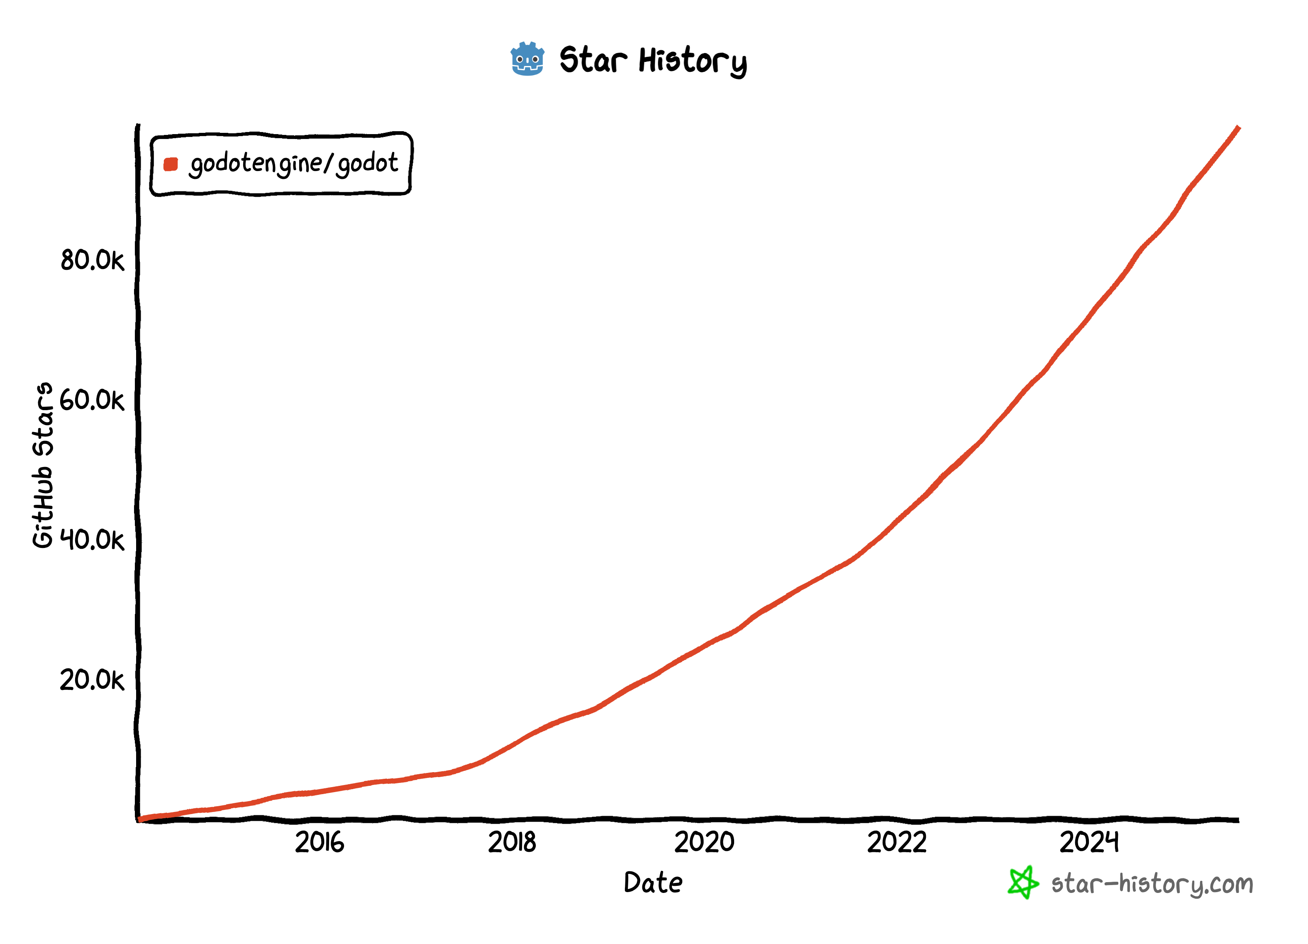
Introduction
What is Godot and why Godot?
In short: Free and open source community-driven 2D and 3D game engine
Developed by the community (Godot was originally developed by Juan Linietsky and Ariel Manzur, two software developers from Argentina.), maintained by Godot Foundation (Dutch non-profit organization. The Foundation was formed on August 23rd, 2022 to administer charitable contributions that are made to the Godot Engine.)
Used for 2D and 3D game development
Gained traction since ~2018, especially in indie community

Slide 4

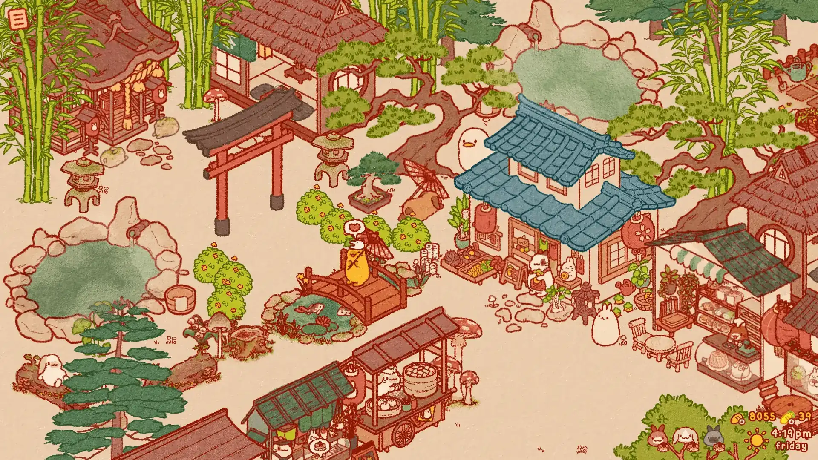
Introduction
Games built by Godot
Usagi Shima
Brotato
Some examples of games created with Godot include Brotato, and Usagi Shima. As for applications, the open source pixel art drawing program Pixelorama is powered by Godot, and so is the voxel RPG creator RPG in a Box.

Slide 5
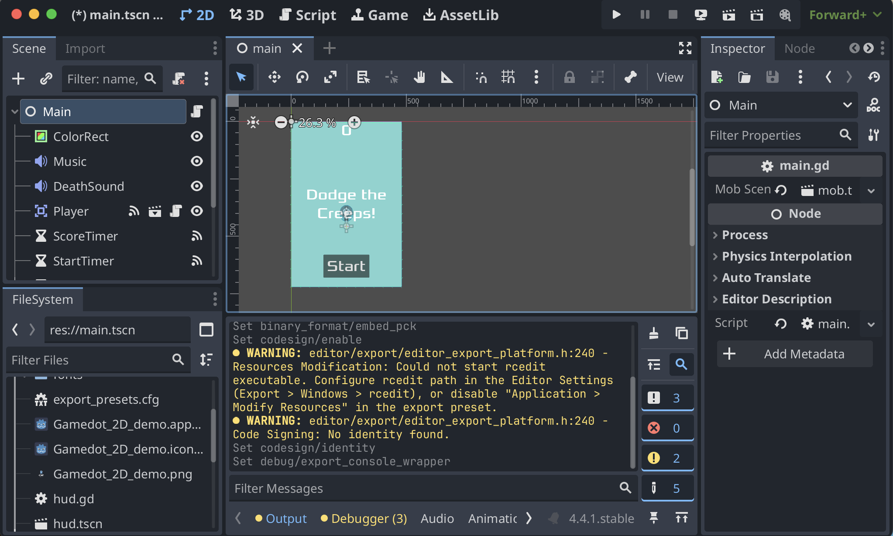
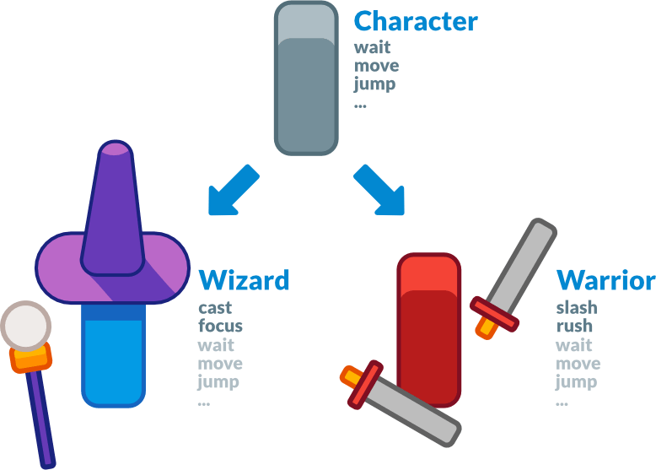
Godot Key Features
Key Features
All-inclusive package (a dedicated scripting workspace, an animation editor, a tilemap editor, a shader editor, a debugger, a profiler, the ability to hot-reload locally and on remote devices, etc.) The Godot editor runs on the game engine. It itself is a game
Built-in physics and animation system
Object-oriented design and composition
Multi-language scripting (GDScript (Yes, Godot developed its own programming language), C#, C++) Godot itself is developed by C++

Slide 6
Godot’s Key Concepts
Scenes, Nodes, Signals, Scene Tree
Node: Nodes are your game's smallest building blocks that you arrange into trees. (Has it’s own state and behavior. Attached directly to script.)
Signal: Nodes emit signals when some event occurs. This feature allows you to make nodes communicate without hard-wiring them in code.
Scene: In Godot, you break down your game in reusable scenes. A scene can be a character, a weapon, a menu in the user interface, a single house, an entire level, or anything you can think of. A scene is composed of one or more nodes. It groups nodes into a functional unit that can be instanced and reused.
Scene Tree: All your game's scenes come together in the scene tree, literally a tree of scenes. And as scenes are trees of nodes, the scene tree also is a tree of nodes.
Scene: Main
Signal
Scene: Player
Node: Timer
Node: AnimatedSprite
Node: CollisionShape
Node: HUD
Root Node: Player
Signal
Node: Audio
Scene: Enemy
Node: VisiableOnScreen
Node: CollisionShape
Root Node: Enemy

Slide 7
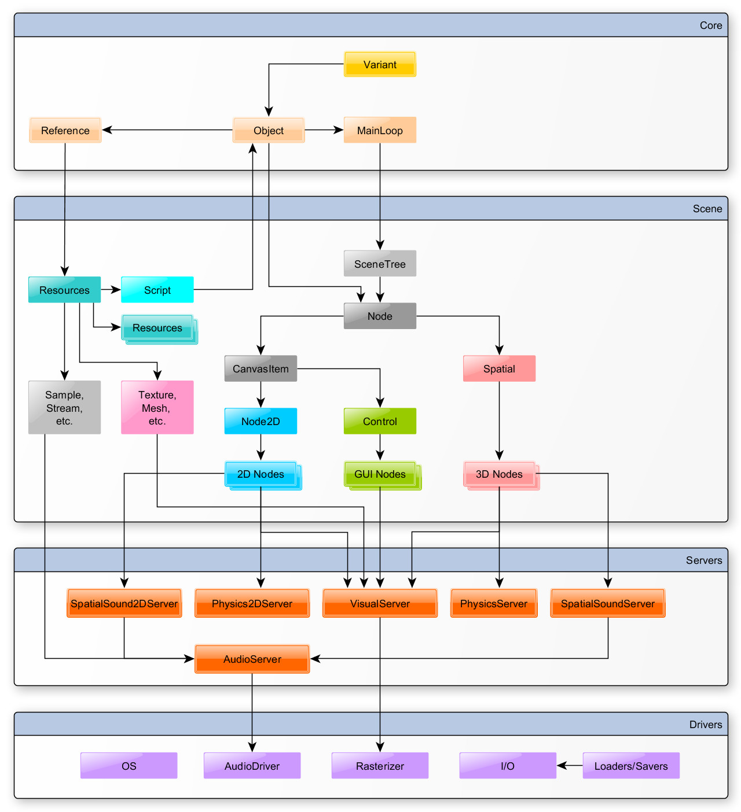
Godot’s Architecture Overview
handles memory, typing, and signal infrastructure
heart of gameplay logic — where scenes, nodes, and resources interact.
Godot’s internal engines. Nodes talk to servers, but you rarely interact with them directly.
ensures portability — one game can run on Windows, Linux, HTML5, etc.

Slide 8
Comparison: Same Game in Both Engines (Compared with EC2)
SHOW ME YOUR CODE GAME.

Slide 9
Resources
Official Doc: https://docs.godotengine.org/
Github: https://github.com/godotengine/godot Youtube: https://www.youtube.com/@Gdquest

